Slide 1
The Ethnic Dimensions
Pamela Oliver
Notre Dame
May 5, 2012
Bringing ethnic divisions & conflict to the center of social movement theory

Slide 2
Outline (A Theme with Variations)
Starting point: thinking about racial disparities and the problem of repression and backlash
Considering the differences between minority and majority movements: a 2-dimensional array
  Why connections matter, not just hiearchies
  Typologizing movements by ethnicity
Unpacking the three dimensions of ethnicity: hierarchy, networks, time (intergenerational transmission)
Applying the ethnic dimension(s) as an analytic framework for understanding all movements
Conclusions

Slide 3
1. The matter of repression
Notes:
This section gives a context for my research.

Slide 4
Prison admission trends
1954 Begin CRM
1970 End CRM and riot era
Notes:
Why did Black imprisonment and the disparities rise after the CRM? The drug war is a big part of the answer.

Slide 5
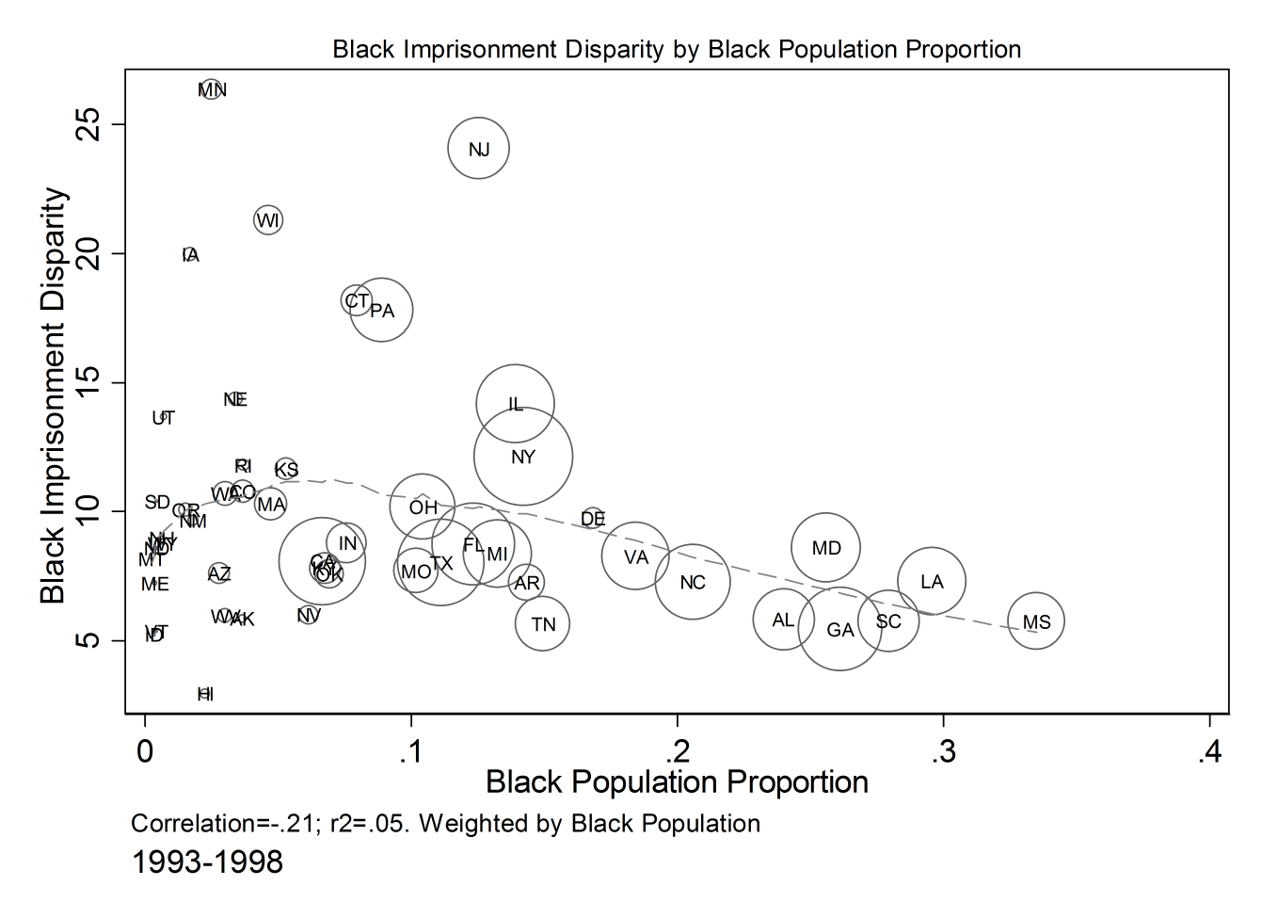
Notes:
This is one of the charts that influenced my thinking. The racial disparity is lower where the percent Black is higher.

Slide 6
Notes:
This is the same idea except using metro areas instead of states; it isn’t all urbanization. The triangles are the non-metro balance in each state. The highest disparity ratios occur in places where the percent Black is small.

Slide 7
The racial disparities movement
Movement addressing racial disparities in criminal justice
Black Movement
People who work in or write about CJ system
Criminal Justice Reform Movement
Latino & other ethnic movements
Notes:
This graph of the movement to address these issues. Participating in the movement also impacts my thinking. I’m “people who work in or write about the CJ system.”

Slide 8
Types of Actors
Offenders & Ex-offenders
Professional &
Elite Reformers
& Advocates
Advocates
Based in
Aggrieved Communities
All the actors in the field
Notes:
The point of the overlap is that a lot of the professions and elite reformers are racial minorities.

Slide 9
Political repression of minorities
Direct
  Non-voting for immigrants
  “Illegal” immigrants at risk of deportation
  Ban language from public spaces, require teaching in dominant language
  Restrictions of religious or cultural garb
Indirect through criminal convictions
  Felon disenfranchisement
  “Community supervision” for long periods
  Deportation of arrestees who are illegal immigrants
9

Slide 10
The sense of repression
The quotation on the next slide was written by Ida Thomas, an older Black woman whose children have been in prison. She describes herself as an uneducated woman who only finished the 9th grade. She wants her name used.
She wrote the statement as her contribution to a meeting of a task force on racial disparities in criminal justice; it was used in the final report. She asked me to edit it so that it would not sound uneducated. I have edited lightly to remove grammatical and spelling errors and have selected part of it. She has read and approved this editing.

Slide 11
What we Blacks fail to realize is that we have invaded their town. We are on their turf now. It’s do like we say or go to prison, for sometimes petty stuff. And we did wrong by coming here, trying to change their ways. They only know how to protect their own color. They are not used to us. Especially the way we think or act. Every race has its own culture. I don’t think this will ever change here. . . . It’s a nice place to live if you can stay out of their system. But can you be sure to do that here? No. It’s like in the slave days here. Yes Madam, yes sir, you are right. Every Black person here is living on borrowed time for freedom. You have to walk a straight and narrow line.. . Many White people do not know how to deal with Blacks here in Wisconsin — they look at us like we are from another planet. Their culture is much different than ours. We think differently, look at life differently. . . .Your best bet is to stay out of trouble if you can here, or you will end up with your back up side the wall like so many have done before. It is said, come down here on vacation, go back on paper. But that’s not true about going back on paper, because sometimes they want you to stay down here and finish your paper here. That’s unfair because if you sneeze the wrong way you will be going to prison to finish up some of your time. You are never free here.
*Written by Ida Thomas July 2009, minor edits & selection by Pamela Oliver
Notes:
This quotation was written by Ida Thomas, an older Black woman whose children have been in prison. She describes herself as an uneducated woman who only finished the 9th grade. She wants her name used. She wrote the statement as her contribution to a meeting of a task force on racial disparities in criminal justice. She asked me to edit it so that it would not sound uneducated. I have edited lightly to remove grammatical and spelling errors. The removed portions deal with other issues, mainly specific recommendations for the task force. I read the edited version to Ida and received her approval to use it in my writing.

Slide 12
Repressive repression
Policing of whole communities, constant surveillance
People “on paper” are intensively repressed from collective or political action
The movement to fight this repression itself suffers (at least indirectly) from the repression of those most affected
  → outside allies, professional movements, activist professionals
  → class and ethnic conflicts within the movement

Slide 13
Linking repression and crime control
Repression
Inter-Group
Conflict
Crime
Control
Protest
& SMs
Crime
Notes:
This is the way I think about repression and crime control

Slide 14
Repression and Backlash
The standard question:
Does repression decrease mobilization through increasing the costs of protest or increase it through increasing grievance?

Slide 15
Backlash and the net effect of repression
Repression
“Repression Works”
Backlash
+
+
Cost & possibility of action
Grievance
—
+
Level of Mobilization

Slide 16
Two over-simplified models
Regime
Regime
Society
Society
Dissenters Criminals
Repressive regime
Crime control

Slide 17
Regime and dissenters are part of the same society
Dissent
Repression
Regime
Society

Slide 18
Ethnic (or other) divisions and the legitimacy of repression

Slide 19
What we know about legitimizing dissent
Repression is Legitimate | Backlash Repression is Illegitimate
Actions of dissenters and regime
Dissenters are violent | Dissenters are peaceful
Repression in proportion to dissent | Repression is overreaction to dissent
Relation between dissenters and the larger society
Many are hurt or inconvenienced by dissent | Few are hurt or inconvenienced by dissent
Dissenters are extremists or outsiders | Dissenters are ordinary people
Dissenters have few ties to the larger society | Dissenters have many ties to the larger society
Repression is narrowly targeted on dissenters | Non-dissenters are repressed

Slide 20
One-way attacks with no repression
Dissent (crime)
Approval of regime
Regime
Discontent with regime
Group 1 Targets (Victims)
Group 2
Dissenters (Aggressors)
Notes:
The only way to get a grip on the problem is to think about groups in society.

Slide 21
One-way attacks with regime repression
Dissent (Crime)
Regime
Punishment
Approval of regime
Discontent with regime
Group 1
Group 2

Slide 22
Imbalanced repression
Crime/ dissent
Regime
Punishment
Approval of regime
Discontent with regime
Group 1
Group 2

Slide 23
Ethnic dominance
Regime identified with one side
Crime/ dissent
Regime
Repression
Approval of regime
Discontent with regime
Group 1
Group 2
Notes:
If the regime is one-sided, it really looks like this. There is a lot of work on nationalism that is all about whose regime it is.

Slide 24
Multi-ethnic control & unbiased repression
Regime
Predictions
Greater balance & targeting in repression
Greater system legitimacy for all?
Political complexities & dynamics

Slide 25
Conclusions about repression & backlash
You cannot analyze repression and backlash without attention to the divisions within a society
  Who are the dissenters?
  Who are the targets?
  Where does the regime stand with respect to the dissenters and the targets?
Repression is uneven
  Much evidence that racial/ethnic minorities are repressed more than majorities
  Weaker groups more repressed than stronger groups
  Less backlash from repressing socially isolated groups
15

Slide 26
2. Ethnicity AS A DIMENSION of network integration

Slide 27
Two Dimensions: Hierarchy X Integration
High in hierarchy or status | Elite movements without mass base |  |  | Elite-led mass Movements
 | Affluent but culturally distinct immigrant groups |  | Non-polarized reform movements
 |  | Reform movements tied to subcultures
 |  |  | Ethnic majority worker or nativist movements
Low in hierarchy or status | Oppressed & segregated minorities |  | Servants living with masters. Women (in some contexts).
 | Fully isolated |  |  | Fully integrated
How I laid this out in Amsterdam in 2009
Notes:
Talk about this slide – how I was thinking about it in Amsterdam. At that time, I was thinking about “the ethnic” as the horizontal dimension.

Slide 28
Relation to Structures of Domination
Aldon Morris & Naomi Braine (2001)
“Theoretical work on social movements has too often assumed that all movements confront basically similar tasks and operate out the same internal logic. This assumption is problematic when applied to the organizational and material factors structuring movement activity; it completely breaks down when applied to cultural dynamics.”
Structures of domination and subordination; multi-institutional systems of domination
Development of oppositional consciousness is different in entrenched subordinate communities than around chosen categories and identities.
Types
  Liberation. Carriers have a historically subordinate position within an ongoing system of social stratification. Movement members are primarily members of the oppressed group; membership is externally imposed. Most are physically segregated
  Equality-based special issue movements. Address issues primarily of affecting an oppressed group. They mobilize liberation ideologies to fight a specific battle. Smaller goals but tied to a larger movement.
  Social responsibility. Challenge conditions affecting the general population. Members choose whether to identify with the group.
Notes:
I’m building on these ideas. I actually dropped this slide and the next in the talk in the interest of time.

Slide 29
Unpacking Morris & Braine
My ideas build on this but break apart the dimensions they conflate
Their analysis treats ethnic/racial or class subordination as similar to gender, sexual minority or disability subordination.
* Oppression, subordination HIERARCHY
* Involuntary group membership externally assigned vs. chosen group membership BOUNDARIES & ASCRIPTION
* Ongoing (typically inter-generational) communities with cultures of opposition and subordination ASCRIPTION, INHERITANCE, CULTURE, BOUNDARIES
*Isolated groups develop oppositional culture more readily NETWORKS
Notes:
Again I ended up dropping this slide.

Slide 30
Movement carriers
The term “movement carrier” is being used here rather loosely to refer to the stratum or segment of society from which the activists in a movement are drawn
This is different from the social movement community concept as it is usually defined to refer to the loose network of activists a movement draws from e.g. Taylor and Whittier 1992, Buechler 1993, Stoecker 1995
But there are other usages of “the community” which are similar to the idea of a “movement carrier”

Slide 31
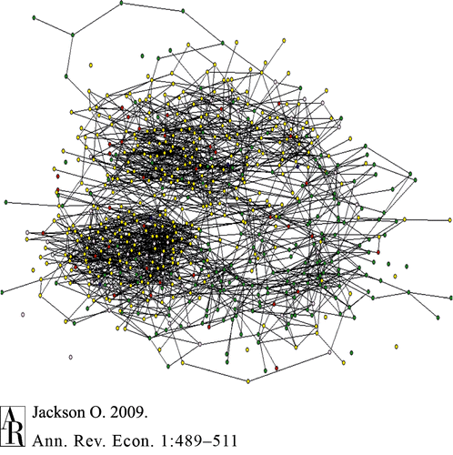
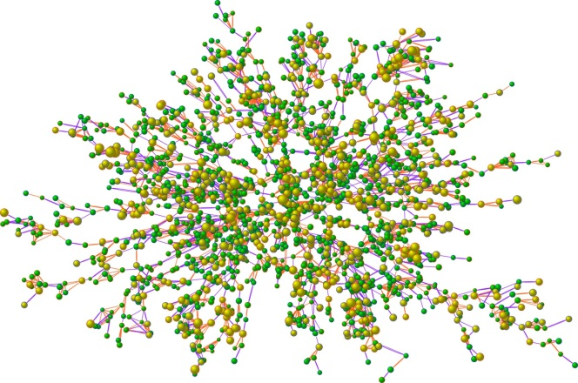
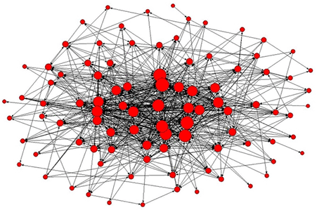
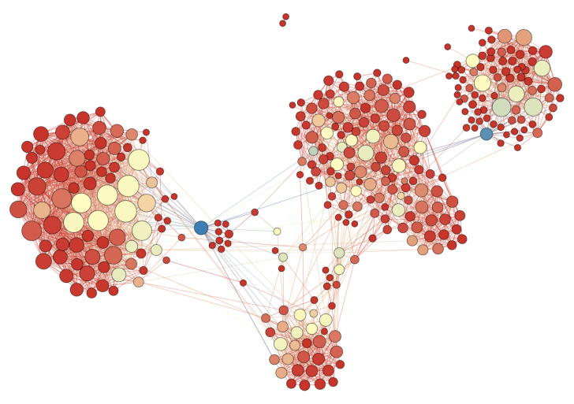
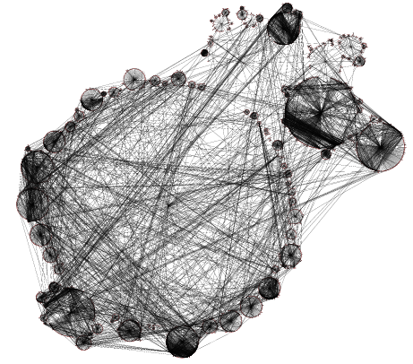
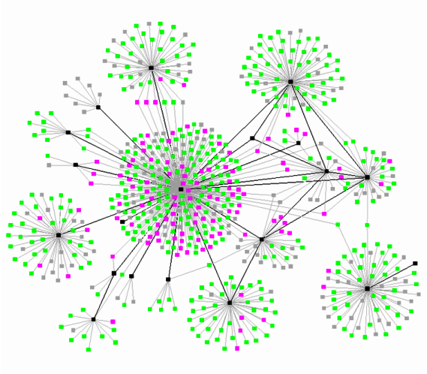
Ethnicity as a cliqued network structure
Notes:
I’m mostly showing these pictures because I spent a lot of time looking for them. Emphasize the difference between cliqued and uncliqued networks.

Slide 32
Class, network & spatial interests
Class interests: Social policies like tax rates or social welfare affect groups of people and affect socially similar people similarly. (Hierarchies)
Indirect or network effects: People in social contact with each other are affected by the impacts on others. Multiplier effects of wealth/poverty or comfort/fear or joy/grief. E.g. a prisoner or a crime victim impacts everyone who knows the person. (Networks)
Spatial interests: people who share a space experience common consequences from crime, repeated protests, trash pickup, etc. (Spatial segregation)

Slide 33
Policies/events affect nearby* people, not just direct target
* Geographically or socially

Slide 34
The degree of segregation of a group affects the scope of the impact on the rest of society of a policy directed toward that group
High class
Low class
Middle class

Slide 35
Cliqued Networks: virtually all the impact is on the low class, none on the high class
High class
Low class
Middle class
Notes:
The point is that racial residential segregation in the US means that Blacks and Latinos are cliqued relative to majority whites.

Slide 36
To emphasize
It is not just a matter of how the issue impacts individual people but the relations between the impacted people and others in society
It is about the degree of correlation between issues
It is about connections (or lack thereof) between different groups of impacted people
Network structure, not just individual status

Slide 37
Movement Carriers vary in their network locations
Network cliquing matters

Slide 38
Structurally, not all axes of dominance/subordination are the same in that they differ in whether/how they form cliqued networks

Slide 39
Women and men in the US, cross-cutting ties with class & ethnicity
women
men
Notes:
The light/dark dimension is class. The gray/red dimension is ethnicity.

Slide 40
Gays & lesbians similarly have cross-cutting ties with class & ethnicity
women
men

Slide 41
Racial/ethnic network cliquing due to residential racial segregation is generally higher than the gender cliquing among US adults
women
men

Slide 42
The structure of ethnic and class cliquing is more complex as both are tied to residential segregation in the US
?

Slide 43
Movements draw from people in different network locations

Slide 44
Summing up the “ethnic dimension” of networks
The horizontal dimension is about who is connected with whom
Ethnicity matters if/when if is a network clique that
  Generates both shared fate within a group and lack of common interests between groups
  Generates conflicts of interest between groups
  Generates common identities within groups and contrasting identities between them
  Generates common understandings of reality and common frames within them and different understandings and frames between them
This horizontal dimension of network connection is different from the vertical dimension of dominance and hierarchy

Slide 45
An Ethnic Typology of Movements
25
Notes:
I’m trying to figure out whether to leave this in and if so, whether this is the right place in the talk for it.

Slide 46
All movements have ethnic dimensions
They are internally homogenous or they are not
They are carried by a dominant ethnie or a minority or subordinate ethnie or are multi-ethnic
They have extensive network ties to the broader society or their networks are highly cliqued and they are isolated
They are relatively central or relatively peripheral to mainstream discourses
They identify with the dominant social groups or they do not

Slide 47
Ethnic Regime Types
My focus
Majority rule (democratic)
  Homogeneous
  Dominant ethnie = nation, minorities suppressed or assimilated
  Multiethnic image of the nation
  Ethnic majority rule with an economically advantaged minority (not considered here)
Minority rule. Non-democratic (not considered here)

Slide 48
Ethnic Regime Types
Ethnic Structures Change Over Time
Majority rule (democratic)
  Homogeneous
  Dominant ethnie = nation, minorities suppressed or assimilated
  Multiethnic image of the nation
  Ethnic majority rule with an economically advantaged minority (not considered here)
Minority rule. Non-democratic (not considered here)
Immigration
Ethnic politics
National liberation

Slide 49
Ethnic Movement Types
Ethnic Majority
Ethnic Minority
Cross-Ethnic
  Majority with minority
  Multi-minority

Slide 50
Ethnic Majority Movement Types
Addressing maintaining domination over or reacting to threats from other ethnic groups (nativism, anti-immigrant, White supremacist)
Addressing axis of domination within the majority
Addressing general social issues (“social responsibility” movements)
Addressing particular local issues
Ally movements supporting other ethnic groups or the less privileged groups within the majority
Anti-minority
These vary from anti- to pro- to indifferent to minorities but are empirically they are ethnic majority
Pro-minority

Slide 51
Majorityness and the facilitation of mobilization
Majorities typically draw on larger pools of potential participants and resources
Majorities have electoral power
Majorities are much less likely to be repressed
Repression of majorities is more likely to generate backlash from other (non-repressed) members of society

Slide 52
Majorityness and the problem for minorities
Majority movements are often problematic for (from the point of view of) minorities
  Often hostile
  Frequently “clueless”
  Even when trying to be pro-minority, can often mess it up

Slide 53
Ethnic minority movement types
Ethnic minority movements (framed as ethnic)
  Civil rights & group advancement movements
  National liberation or secessionist movements
  “Intersectional” movements linking social responsibility or gender or class with ethnicity
Movements of ethnic minorities
  Class movements that are empirically mostly minority
  Place-based community issues
  Oppressed and repressed minorities, e.g. felons, undocumented workers

Slide 54
Minority movements and the hierarchy and network problems
Oppression and repression are common and real issues
  Much evidence of more severe repression of minorities
  Morris: cultures of opposition and cultures of subordination tend to intermingle; the problem of consciousness
Ethnic minorities typically lack sufficient resources and political power to achieve their goals without majority allies

Slide 55
Variability among minorities: no general theory of “minority”
In the US, each racial/ethnic minority (Black, Native, Hispanic, Asian) has a distinctive movement history that is linked to its specific social network position
  Group size
  Created by conquest vs. immigration
  Degree of historic violent suppression
  Degree of disadvantage
  Historic rituals of subordination
  Location in urban vs. rural areas, concentrated vs. dispersed populations
  Language & cultural homogeneity or diversity
  Character of ethnic identity: unified (esp. Black) vs. diverse (all the others)
  Citizenship status
  Cultures of resistance and subordination
  Characteristic strategies and tactics
  Mixture of integrationist and separatist tendencies
Similarly complex to consider other countries
Notes:
I just waved my hands at this: each “minority” is in a very specific and different situation.

Slide 56
Strategies of ethnic minorities are in interaction with strategies of the dominant majority
Degree of Challenge | Low
 | Medium
 | High
 |  | Assimilate | Multicultural | Separatist | Nationalist
Notes:
If the dominant majority is trying to force you to assimilate, then assimilation is low challenge and insisting on staying separate is high challenge. But if the dominant majority if trying to segregate you or expel you, then insisting on integration or assimilation can be high challenge. The real point is that the strategy choices of minorities are complex and multi-dimensional.

Slide 57
Cross-ethnic movements
Majority-majority mixed-ethnic movements
  Movements around non-ethnic issues
  Majority movements that have minority outreach programs e.g. Communists & Socialists in the 1930s US
  Professionalized advocates working with or for disadvantaged oppressed minorities
Majority-minority mixed-ethnic movements
  Groups dominated by one or more minorities that others join
  Coalitions between groups with different ethnic configurations
  Mobilizations from multi-ethnic constituencies

Slide 58
The racial disparities movement
Movement addressing racial disparities in criminal justice
Black Movement
People who work in or write about CJ system
Criminal Justice Reform Movement
Latino & other ethnic movements
Notes:
Again just a reminder of my context.

Slide 59
Types of Actors
Offenders & Ex-offenders
Professional &
Elite Reformers
& Advocates
Advocates
Based in
Aggrieved Communities
All the actors in the field
Notes:
The point of the overlap is that a lot of the professions and elite reformers are racial minorities. My own experience is especially in this type of movement.

Slide 60
Tensions in cross-ethnic movements
Privilege issues
Hierarchical & power issues
Network cliquing issues
Agenda issues

Slide 61
Privilege issues in cross-ethnic movements
Hierarchies are often replicated within the movement, often unconsciously
Differential resources: email, copiers, travel money, computers, days off, discretionary time
Differential skills and self-assurance in talking and writing
Differential habits of dominance or submission
Access to information?

Slide 62
Hierarchy and power Issues in cross-ethnic movements
Differential access to power
  Network ties to power holders
  Being seen as knowledgeable, objective by outsiders
Differential risk of repression
Differential control over the purse strings of the organization due to funding source
Gate-keeper to jobs or benefits needed by others

Slide 63
Network issues in cross-ethnic movements
Different experiences give radically different views of “reality”
Different cultural practices about how to “do” movements
Different ways of talking and framing issues
Different identities
Different languages
Different customs about holding meetings and having discussions

Slide 64
Agenda issues in cross-ethnic movements
Commitment issues: are “conscience constituents” or allies in for the long haul or can they just leave?
Shared fate issues: who will suffer consequences if things go wrong?
Divergent goals based on different experiences and positions
Leadership issues: who’s in charge?
Conflicts over resources within the movement e.g. access to paid positions, allocation of funding to different groups
40

Slide 65
3. Theorizing ethnicity
From ethnicity as a dimension to the dimensions of ethnicity

Slide 66
Two Dimensions: Hierarchy X Integration
High in hierarchy or status | Elite movements without mass base |  |  | Elite-led mass Movements
 | Affluent but culturally distinct immigrant groups |  | Non-polarized reform movements
 |  | Reform movements tied to subcultures
 |  |  | Ethnic majority worker or nativist movements
Low in hierarchy or status | Oppressed & segregated minorities |  | Servants living with masters. Women (in some contexts).
 | Fully isolated |  |  | Fully integrated
How I laid this out in Amsterdam in 2009
Notes:
So instead of treating ethnicity as the horizontal axis, now I’m thinking of ethnicity as a multi-dimensional space.

Slide 67
The vertical dimensions

Slide 68
Vertical (Hierarchical) Dimensions of Ethnicity
Numbers (group size)
Resources (wealth, land)
Political power (control of government, coercion)
Day-to-day restrictions on life (segregation, surveillance, exclusion)
Symbolic/cultural dominance (rituals of submission, enforced ignorance, suppress culture/language or enforce separate culture/language, ascription)

Slide 69
Ethnic Groups Vary in Resources, Resource Distributions, or Degree of Internal Stratification

Slide 70
The vertical hierarchical dimension affects the horizontal network dimension
Exclusion
Rituals of Subordination
Spatial segregation & cliqued networks
Access to Resources

Slide 71
Structures of domination that are “ethnic” not only are hierarchical but also create social segregation and cultural difference

Slide 72
The Third dimension Of Ethnicity: Time and intergenerational transmission
Notes:
In this section, I want to talk very generally about what ethnicity is so that we can extract its analytic essence. I’m trying to distill what I think the core issues are in this field.

Slide 73
Ethnicity is intergenerational & Ascribed
Group 1
Group 1
Group 2
Group 2
You are born with an ethnicity
You inherit it from your parents
You are acculturated into your ethnicity in childhood
Notes:
In this section I do a “baby talk” version of ethnicity as intergenerational to make a point about thinking about ethnicity.

Slide 74
Race and Ethnicity
Both are inter-generational: you inherit them from your parents
Race is understood to refer to physical groupings of people based on ancestral geographic origins
Ethnicity is understood to refer to groupings based on culture
They are logically distinct
They overlap in practice
They tend to be used interchangeably in ordinary life
* Race is often harder for an individual to change or disguise than ethnicity
Notes:
The point here is that I’m treating race and ethnicity as the same in this talk even though they are not exactly the same but they overlap a lot.

Slide 75
Ethnicities (and races) are lineages that stay distinct if and only if they are physically & socially segregated and do not intermarry
Group 1
Group 1
Group 2
Group 2

Slide 76
Ethnicity
Lineage
Inter-generational inheritance
Group Boundaries
Distinct Cultural Practices
Notes:
These three aspects of ethnicity reinforce each other

Slide 77
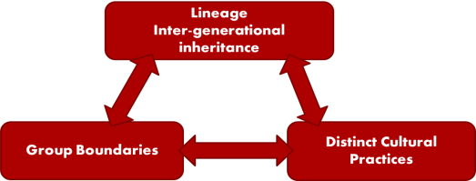
Lineage
Inter-generational inheritance
Lineage
Inter-generational inheritance
Group Boundaries
Distinct Cultural Practices
Group Boundaries
Distinct Cultural Practices
Construction of group boundaries is a big topic in race & ethnicity
  Mutable
  Contested
Cultures always blending, being defined and re-defined in interaction with other ethnicities
Notes:
The point of this picture is that ethnicities always exist in interaction with each other and are defined with respect to each other.

Slide 78
Historically, ethnicities diverged through migration, separation or segregation that prevent intermixing and lead to separate languages & cultures.
Group 1
Original Group
Group 2

Slide 79
Political or social forces bring the groups back into contact

Slide 80
Initially distinct groups that intermarry become one group across generations
Group 1
New Combined Group
Group 2

Slide 81
How groups merge varies a lot between societies
Group 1
Group 1
Group 1
Group 2
New Combined Group
Group 1
Group 2
Group 1
Group 2
Group 2
Notes:
There are many different rules and practices for the definitions of groups and group boundaries as groups mix.

Slide 82
Ongoing processes of construction and reconstruction of ethnic groups are tied to how much they mix and also the rules of mixing
Group 1
Group 1
Group 1
Group 1
Group 2
Group 2
Group 2
Group 1
Group 1
Group 1
New Combined Group
Group 2
Group 2
Group 2
Notes:
The point is that staying separate or mixing and the rules of mixing are always in flux and contested.

Slide 83
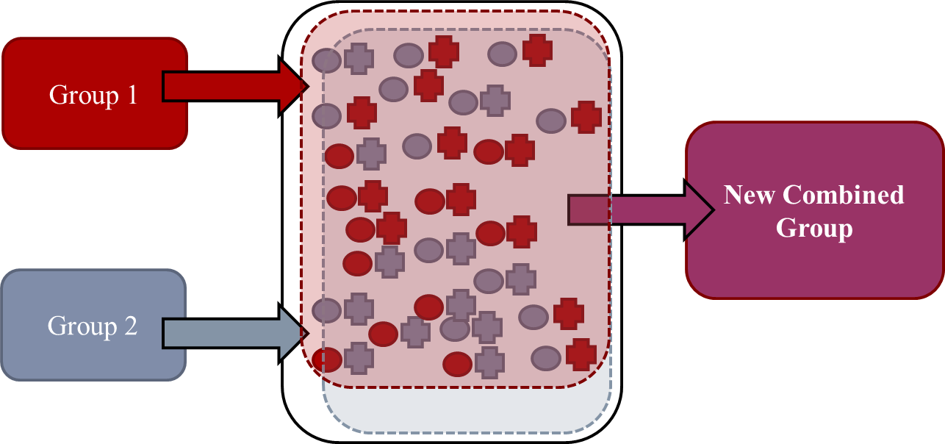
Sometimes groups are forced to assimilate or merge by outside political forces.
Notes:
Political pressures and structures shape ethnic merger, including national borders, relatively benign programs of spatial integration and cultural assimilation, and coercive programs of relocation and forced assimilation. Merger of captured Africans in slavery. Many states have suppressed language minorities, and some states have suppressed the language and culture of other countries they conquered.

Slide 84
Sometimes politicized ethnic conflict separates mixing or mixed people.
Group 1
Group 2
Notes:
If people have intermarried, it is always a problem about what happens to the people, but politicized conflict has blown apart groups that were, in fact, mixing. Sarajevo, Rwanda, German Jews.

Slide 85
The Dimensions of Ethnicity reinforce each other

Slide 86
Across time, ethnic hierarchies tend to reduce ethnic assimilation (networks, boundaries) and increase cultural difference
Hierarchy
Segregation
Cultural Difference

Slide 87
There are cases in which dominant ethnicities seek to erase cultural differences among minorities.
Hierarchy
Segregation
Cultural Difference
Notes:
I’m not really theorizing this, just stipulating the point that both the maintenance of difference and the erasure of difference can be products of hierarchy.

Slide 88
4. The Ethnic Dimensions as Analytic tools
Broadening the idea of “ethnic” to apply to other kinds of groups

Slide 89
Notes:
The surface means nothing at all, I just had to define a surface to get Excel to create the three-dimensional box, which is my real interest. The point is that I’m now thinking of ethnicity as a set of dimensions: vertical or hierarchical, horizontal or network structure, and temporal or intergenerational inheritance.

Slide 90
Class and ethnicity
Class is often ethnic
  Conquest
  Differential immigration
Ethnic differences often disrupt class unity
Within “the same” ethnicity, class is ethnic if classes are socially and spatially segregated and do not intermarry.
Reduction in class intermarriage is a marker of a rigidifying class structure; increase in intermarriage of an opening class structure.

Slide 91
Gender
The network structure of gender is different from ethnicity
  Sexes are not lineages
  Sexes are not spatially and socially segregated: different sexes occupy the same households
  “Intersectionality” – gender hierarchies interact with class & ethnicity
Sex-segregated networks and cultures could be understood in ethnic terms
Sexual minorities are not lineages, do have distinct subcultures, may be segregated
The principles of the interrelations among hierarchy, segregation and cultural difference apply to women and sexual minorities

Slide 92
Intergenerational movements
Groups you are born into and grow up in are different from groups you join as adults. **Why race & ethnicity are “different”**
There are languages and cultures that are transmitted from child to child or young adult to young adult
  Children’s games
  Creole languages, street dialects
  Youth cultures
Ethnic dimension: the extent to which movement cultures or movement communities have an intergenerational component

Slide 93
Movement/political subcultures as proto-ethnic
Movements that are transmitted across generations from parents to children are (or can be seen as) ethnic movements
Many overlay “real” ethnic groups
Group 1
Group 1
Group 2
Group 2
Spatial & social segregation of political subcultures →
  proto-ethnic
Inter-generational transmission of movement culture outside families parallels creoles & other dialects taught across child generations

Slide 94
Ethnic “universes of discourse”
How people in different ethnic groups talk about issues
Understandings of what is “real”
Language and signification

Slide 95
Proto-ethnic movement cultures?
Polarized liberal & conservative politics
Religious versus secular subcultures
Class cultures.
Sectarian or extremist politicos or religious sects
Notes:
The next few graphs of the liberal-conservative divide are to illustrate the idea of political cultures as proto-ethnic.

Slide 96
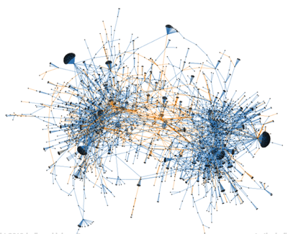
Tweets with the #GOP hashtag. Mostly within liberal or conservative. Orange are mentions across communities.
Notes:
Graphic produced by truthy.indiana.edu.
The #GOP hashtag is widely used and an example of a popular, grassroots meme. In the diffusion network we can often observe two clearly separated clusters. These correspond to conservative and liberal communities, using the tag in different ways. People tend to retweet others in the same community and not in the other community, so we see the clusters in blue. We also see orange edges connecting the two communities. These occur when users mention people in the other community, typically to disagree or criticize.

Slide 97
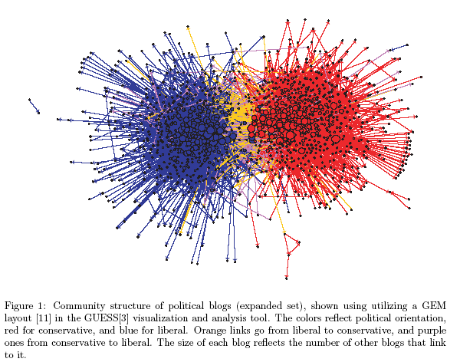
Lada Adamic, HP Labs, Palo Alto, CA and Natalie Glance. “The Political Blogosphere and the 2004 U.S. Election: Divided They Blog”, March 4, 2005 . (This image is all over the Internet, but it was surprisingly difficult to find the original and reference)

Slide 98
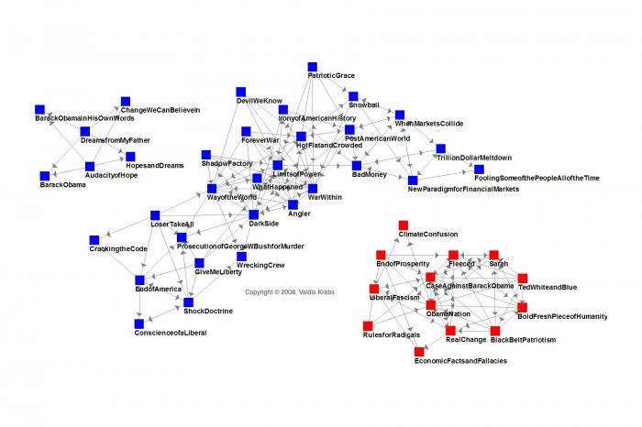
Book purchases http://orgtheory.wordpress.com/2008/10/29/the-latest-book-network-and-saul-alinsky/ who is citing http://www.thenetworkthinker.com/2008/10/complete-polarization.html Valdis Krebs

Slide 99
V. Recapitulation

Slide 100
From ethnicity as a single trait or dimension

Slide 101
Two Dimensions: Hierarchy X Integration
High in hierarchy or status | Elite movements without mass base |  |  | Elite-led mass Movements
 | Affluent but culturally distinct immigrant groups |  | Non-polarized reform movements
 |  | Reform movements tied to subcultures
 |  |  | Ethnic majority worker or nativist movements
Low in hierarchy or status | Oppressed & segregated minorities |  | Servants living with masters. Women (in some contexts).
 | Fully isolated |  |  | Fully integrated
How I laid this out in Amsterdam in 2009

Slide 102
To the ethnic dimensions as analytic tools for understanding movement carriers and movement types

Slide 104
Making the ethnic dimensions central
Movement carriers are in different ethnic-structural locations that affect everything about them
  Mobilization processes
  Choice of strategy/tactics
  Core framing tasks & consciousness raising
  Likelihood of repression
  Ability to influence the larger society
These dimensions of difference are theoretically central not afterthoughts
“General” social movement theory that ignores this is a theory of majority movements

Slide 105
Studying non-movements not just movements
Subordination and network isolation make mobilization difficult and repression likely → no movement
Equality and network integration make mobilization unnecessary → no movement
Movements that do not exist are as theoretically interesting as movements that do exist
Studying only movements that exist is a selection bias problem
Examine the theoretical space of movement carriers and the existence of subordination and look for what is not there as well as what is there

Slide 106
The Problem of “unexplained” ideological divergence
  Can the idea of the ethnic help to explain the content of movements and why people in the same class position end up in opposite political camps?
  People of different ideological views live in different neighborhoods, participate in different religious or secular organizations, read or watch different information sources.
  Radically different “universes of discourse” can be easily identified both between ethnic groups and within the majority around these ideological issues
  When people encounter the discourses from unfamiliar universes of discourse, the response tends to be outrage and polarization, not influence

Slide 107
Understanding the Content of Movements
Walder’s critique: a decline in the interest of movement scholars in explaining the content of movements in favor of mobilization-centric theory
The failure of “old” class-centric or deprivation theory to provide adequate explanations
The ethnic dimension provides a way to integrate thinking about structures of domination, prospects for mobilization, and the cultural network cliquing that shapes identity formation, framing, and ideology

Slide 108
There is much to do.

Slide 109
The End
Thank you

Slide 110
Summary of Walder’s Critique
Decline of attempt to relate character of movements to social structure, to explain variations in political views.
Critique of exclusive focus on mobilization. (A critique that generally applies to me)
A call for the study of the content of movements
Examples of studies of content of movements
  Studies showing structural factors like class to account for political differences or factions but are instead explained by short-term changes in identity formation.
  Studies of ethnic mobilization, seeking to explain when and why ethnic identity becomes salient as a cause of conflict.
  Studies of variations in union mobilization
  Studies of impact of religious ideas on political orientations

Slide 111
IV. Ethnic Conflicts Within Movements
Cultural & political differences
Hierarchical differences
Conflicts are endemic to any heterogeneous group

Slide 112
Cultural differences
Different cultural standards for how to run a meeting, what is a polite way to talk
What forms of action are meaningful
Different perceptions of what the issues are
Different perceptions of how to produce social change

Slide 113
Hierarchy differences
Education and forms of cultural capital limit who can engage in different forms of action
Organizing meetings & work by email (Facebook Twitter etc) can exclude those who do not have home computers
Elite reformers often bring assumptions of superiority into the field, expect deference
Resentment by aggrieved beneficiary constituents of domination, forms of action of elite allies
Poor and uneducated people are sometimes mis-informed. (So are affluent and educated people.)
16

Slide 114
Examples of conflicts in my work -1
Outsiders listen to Whites more on race issues, Blacks delegitimated as speakers on race issues. Convicted criminals delegitimated on punishment issues. Illegal immigrants can say anything.
  Leads to frustration, anger, silencing of the principals
Wildly different views of what “the problem” is
  Poverty leading to bad behavior?
  Differential treatment for the same behavior?
  Is the policing too rigorous or does Madison have a higher (better) standard of behavior?
Skip if past 17

Slide 115
Examples of conflicts in my work -2
Institutional reformers care about issues but react with threat if attributions of personal racism or malfeasance are made (even about others in the organization)
Taking offense: cultural practices about public disagreement, cultural differences in what is offensive
  “legal pretender”
  complaints about unfair policing are taken personally
  Story about 4 stops after the rally
  “Making nice” vs. not with people you disagree with
Example of a person literally being talked over, viewed as hostile when she (in a hostile tone) complained about it

Slide 116
Examples of conflicts in my work -3
Concerns about allocation of social service funding: complaints that minorities are the “clients” but Whites get the jobs serving them -> implicit conflict of interest among allies on the issues
Poor people, especially released felons, need jobs badly, cannot afford to volunteer, look to movement for employment, may lead to “corruption” of non-profit law
Conflict that led an advocacy group leader to call a parole officer on a group member
Some CJ professionals are literally unaware of how the system works (often perversely) in areas slightly out of their purview

Slide 117
Examples of Conflicts in my work -4-
Capacity to contribute in a mixed-class arena is heavily dominated by education, professional status
  Ability to do research, write reports
  Sensitivity to being thought ignorant or uneducated
Internet and email: professionals have ready access, prefer to communicate that way, exclude poorer people who do not have the same access
  Meeting-scheduling woes
  Reading drafts, getting work in on time
  Example of frustration leading to conflict & tears

Slide 118
Examples of conflicts in my work -5-
Different minorities have different issues
  Conflicts between Blacks & Hispanic immigrants about whose issues are most important
Conflicts between moderates and radicals.
Racial-cultural differences in the structure of the issue
  Whites divide into “liberals” focusing on structure & disadvantage versus “conservatives” focusing on problems of Black crime
  Blacks do not make this distinction: concerned about crime and see it as a product of discrimination

Slide 119
In sum
Conflicts are the norm in groups that mix people from different cultural backgrounds & class positions
  ESPECIALLY if the “beneficiary constituents” are poor &/or oppressed and the “conscience constituents” are affluent and relatively powerful
Most groups become more homogeneous over time, even if they start as mixed
  One group tends to dominate the organization
  Others move on, sometimes quietly disappearing, sometimes after an ugly fight
Read this one

Slide 120
V. Ethnicity and New Communications Media
Class and access to new media
  This is also a global issue
  Lower class groups and less developed countries are not using Facebook and Twitter
Ethnicity & nationality & language
  New media are highly segregated
  Tend to reproduce or even exacerbate existing ethnic (social, political) boundaries, little evidence that it lessens them
  The virulence of between-group hostilities seems exacerbated in the new media
17

Slide 121
VI. Inter-Movement Competition
Movements compete not only with their direct opponents but with other movements
  For attention
  For resources
  For personnel
These inter-movement competitions have ethnic dimensions
  Dominant and integrated groups compete better than subordinate and isolated groups
  Elite allies are often necessary, raise the conflicts described earlier

Slide 122
Conclusion
Broadening “ethnic” to encompass not just the usual popular understanding
  Think of it as patterns of networks and cliques
  Applies to religious groups, political groups
  It is the question of ties outside the group
  And the question of hierarchy
These divisions and dimensions should be central to all theorizing: fundamental axes of variation among types of movements
20

Slide 123
All movements have an ethnic dimension
They are internally homogenous or they are not
Part of dominant ethnie or not
Relatively central or peripheral to mainstream discourses
Identify or not with the dominant social groups

Slide 124
Proto-ethnic?
Can the class, political or religious divisions among White Americans be understood as proto-ethnic?
  Few network ties between groups, network cliquing
  Spatial segregation
  Inter-generational inheritance and socialization

Slide 125
Are the classes mixing among Whites?

Slide 126
OR are classes becoming cliqued among Whites? Are intermarriage rates falling between occupational, educational, and class groups?

Slide 127
Is ideological polarization among Whites leading to cliquing and proto-ethnicization?

Slide 128
Graphic produced by truthy.indiana.edu.
The #GOP hashtag is widely used and an example of a popular, grassroots meme. In the diffusion network we can often observe two clearly separated clusters. These correspond to conservative and liberal communities, using the tag in different ways. People tend to retweet others in the same community and not in the other community, so we see the clusters in blue. We also see orange edges connecting the two communities. These occur when users mention people in the other community, typically to disagree or criticize.

Slide 129
Lada Adamic, HP Labs, Palo Alto, CA and Natalie Glance. “The Political Blogosphere and the 2004 U.S. Election: Divided They Blog”, March 4, 2005 . (This image is all over the Internet, but it was surprisingly difficult to find the original and reference)

Slide 130
Book purchases http://orgtheory.wordpress.com/2008/10/29/the-latest-book-network-and-saul-alinsky/ who is citing http://www.thenetworkthinker.com/2008/10/complete-polarization.html Valdis Krebs

Slide 131
The end
Thank you.

Slide 132
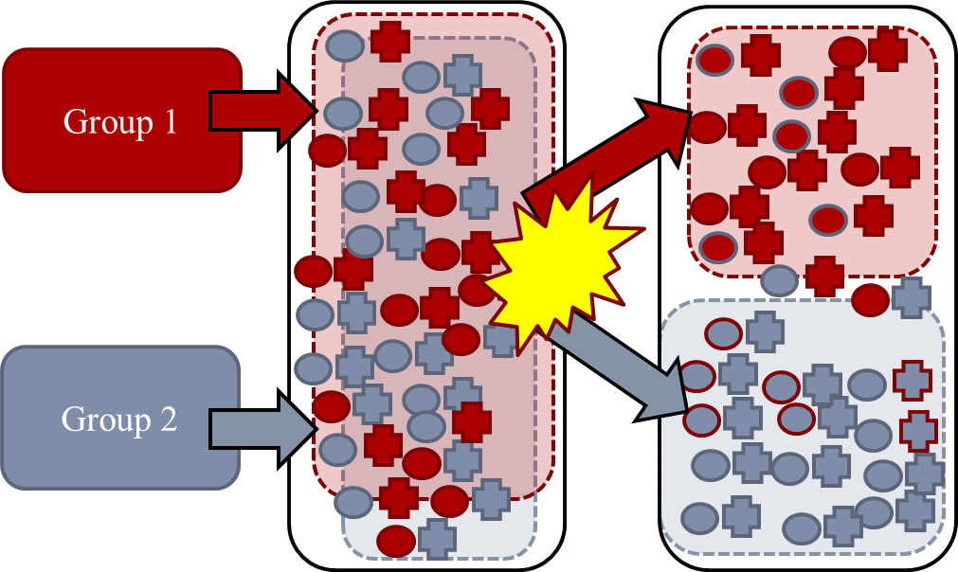
Politics and conflict can re-separate groups that have been merging
Segregation and anti-miscegenation laws designed to keep groups apart
Politicized ethnic group conflict raises salience of ethnic origins among a mixing/mixed population
  Jews in Germany
  Sarajevo
  Rwanda
Resistance to cultural domination can take the form of increasing or exaggerating language or cultural divergence from the dominant group
Overt ethnic conflicts can paradoxically be most overt as groups are actually mixing and blending

Slide 133
The converse is also true: across time, equality between groups is tied to integration and cultural mixing
Equality
Integration
Cultural mixing and Convergence

Slide 134
Relation to Structures of Domination
Aldon Morris & Naomi Braine (2001)
“Theoretical work on social movements has too often assumed that all movements confront basically similar tasks and operate out the same internal logic. This assumption is problematic when applied to the organizational and material factors structuring movement activity; it completely breaks down when applied to cultural dynamics.”
Structures of domination and subordination; multi-institutional systems of domination
Development of oppositional consciousness is different in entrenched subordinate communities than around chosen categories and identities.
Types
  Liberation. Carriers have a historically subordinate position within an ongoing system of social stratification. Movement members are primarily members of the oppressed group; membership is externally imposed. Most are physically segregated
  Equality-based special issue movements. Address issues primarily of affecting an oppressed group. They mobilize liberation ideologies to fight a specific battle. Smaller goals but tied to a larger movement.
  Social responsibility. Challenge conditions affecting the general population. Members choose whether to identify with the group.

Slide 135
Unpacking Morris & Braine
My ideas build on this but break apart the dimensions they conflate
Their analysis treats ethnic/racial or class subordination as similar to gender, sexual minority or disability subordination.
* Oppression, subordination HIERARCHY
* Involuntary group membership externally assigned vs. chosen group membership BOUNDARIES & ASCRIPTION
* Ongoing (typically inter-generational) communities with cultures of opposition and subordination ASCRIPTION, INHERITANCE, CULTURE, BOUNDARIES
*Isolated groups develop oppositional culture more readily NETWORKS

Slide 136
Ethnic Regime Types
Majority rule (democratic)
  Homogeneous
    A common national myth, rarely completely true
    If mostly true, a product of past forced or natural assimilation or blending
  Dominant ethnie = nation, minorities suppressed or assimilated
    Melting pot in US CREATED a dominant ethnie of White Americans, forced ethnic Europeans to be White Americans
    Similar stories in Europe, Japan etc.
    Comparative nationalisms e.g. France vs. Germany
    Different minorities have different relations to the majority. Some may be economically advantaged
  Multiethnic image of the nation
    Brazil, Canada, US today?
    Ethnic politics
    Different minorities have different relations to the majority
  Ethnic majority rule with an economically advantaged minority (e.g. Whites in modern South Africa, Chinese in Malaysia or Indonesia). Not considered here.
Minority rule (special case not considered here). Non-democratic

Slide 137
Hierarchies that vary within as well as between ethnicities
Resources
  Wealth
  Control of means of production, control of commercial establishments
  Control of key institutions: education, medicine, entertainment, culture
Political power: numbers + resources
  Coercive: control over means of violence (vs. target of violence)
  Control of the machinery of government (vs. exclusion)
  Control of policies
Symbolic/cultural dominance (non-ethnic, i.e. gender, age, or sexual orientation)
  Ascribed group membership
  Enforced ignorance, inadequate education
  Stigmatize or ban a group’s language or cultural practices
  Rituals of dominance and submission, practices enforcing symbolic hierarchies & distinctions
These forms of domination can vary within ethnic boundaries as well as between them. If these cross-cut ethnic boundaries, ethnic hierarchies may be reduced

Slide 138
Hierarchies Linked to Networks
Numbers (group size)
  Electoral power: function of relative group size + suffrage
  Cultural dominance
Day-to-day restrictions on life
  Physical segregation, exclusion from some places, privileged access to places
  Surveillance and control, passport checks, reporting to authorities, curfews, etc.
  Exclusion from key institutions or arenas of life (e.g. education, religion)
Symbolic/cultural dominance
  Ascribed group membership
  Enforced ignorance, inadequate education
  Stigmatize or ban a group’s language or cultural practices
  Rituals of dominance and submission, practices enforcing symbolic hierarchies & distinctions
Sheer size matters & is itself a product of group formation
These forms of domination tend to create/enforce group boundaries and network cliquing → ethnic groups

